Slide 1



The Tech Leadership Academy is made possible by generous funding from Microsoft Community Affairs
These materials are available under the Creative Commons Attribution-NonCommercial 3.0 License.

Slide 2

Turning the Pyramid Upside Down
The Impact and Future of Technology in Nonprofits
August 30, 2010
Edward G. Happ
Global CIO, IFRC
Chairman, NetHope

Slide 3
Session 1: Future of IT in Nonprofits
Recognize the role of technology in moving missions forward
Use pyramid framework to strategically understand different roles of technology in organizations
Learn where to look for future trends before they disrupt you
Use the “discover and harvest approach” to discover and amplify pockets of innovation

Slide 4
I. Some Strategic Context

Slide 5
What’s the single most important strategic question?

Slide 6
What’s my destination?

Slide 7
NGO IT Strategy: Moving the Agenda Up the Pyramid
Competitive
or Leading
BENEFICIARY
“Differentiating”
Beneficiary & Field Facing
PROGRAM
“Improving Program Delivery”
Increasing Impact for Beneficiaries
OPERATIONAL
“Helping the Organization Run”
Efficient
Donor & HQ
Facing
FOUNDATIONAL
“Keeping the Lights On”
7

Slide 8
Technology is a Key to Building Capacity
More Effective Impact
At Greater Scale
Effective, Efficient, Scalable Programs
Hiring
Training
Partnering
Advocacy
Tools
Processes
Standards
Systems Impact
Funding Support

Slide 9
The Problem: NGOs invest a fifth of corp. IT
5x
18x
4x
9
Notes:
9
9

Slide 10
Closing the Productivity Gap: A New Calculus
A back of the envelop calculation for taking a $5M IT
department in a $200M NGO to $23M
Charity Factor
Collaboration Factor
56%
Gap Remains
10
Notes:
A fictitious $200M NGO; 1,700 users

Slide 11
Leveling the NGO - Corp IT Playing Field

Slide 12
Non Profit IT Departments Can’t Play the Odds
IF
57% of ERP projects don't realize their ROI (Nucleus Research)
66% IT projects fail (Standish Chaos DB)
NGOs spend a 20th what corporations do (Tuck survey)
And we are spending donors’ dollars
THEN
We must find a better way...
12
Notes:
12

Slide 13
Key Conclusion: we can’t do it alone
Even if we tripled IT spending, we will still be playing catch-up for just keeping the lights on.
And…
Notes:
13

Slide 14
Keeping the Lights-On is Irrelevant
It’s more a commodity each day
“We can't get close to what Google and Amazon can do in their data centers”
–Peter Cochrane
14

Slide 15
We Need to Push the Pyramid at Both Ends
Get in
Competitive
or Leading
BENEFICIARY
“Differentiating”
Beneficiary & Field Facing
Increasing Impact for Beneficiaries
PROGRAM
“Improving Program Delivery”
OPERATIONAL
“Helping the Organization Run”
Efficient
Donor & HQ
Facing
FOUNDATIONAL
“Keeping the Lights On”
Get out

Slide 16

Advice from a Hockey Legend
“I skate to where the puck is going to be,
not where it has been.” --Wayne Gretzky

Slide 17
II. Looking to the Future – Part 1

Slide 18
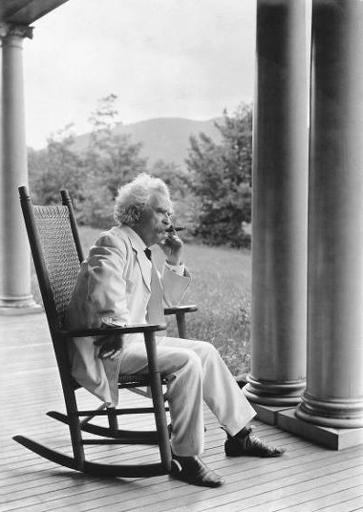
It’s More about Practices than Forecasts
"The art of prophecy is very difficult-- especially with respect to the future." --Mark Twain
18

Slide 19
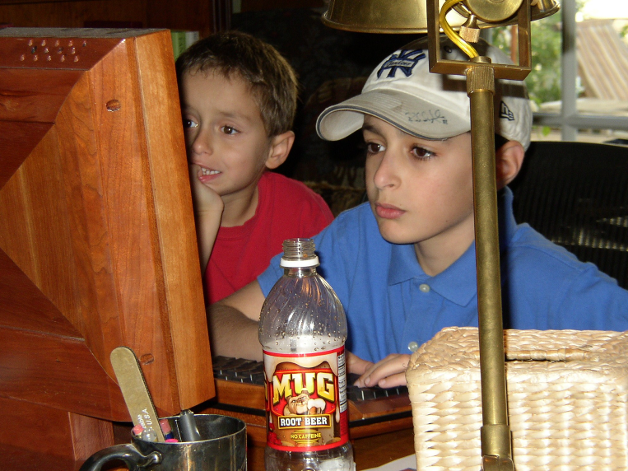
Who is Your Leading Indicator?
19

Slide 20
Who are you spending time with?
“If you’re a CIO, you need to spend a lot of time out on the fringes of the Web because that’s where the innovation’s taking place. You need to spend a lot of time with people under 25 years old.”
–Gary Hamel
Notes:
Gary Hamel interview, CIO Magazine, November 15, 2007, p. 50-55.

Slide 21
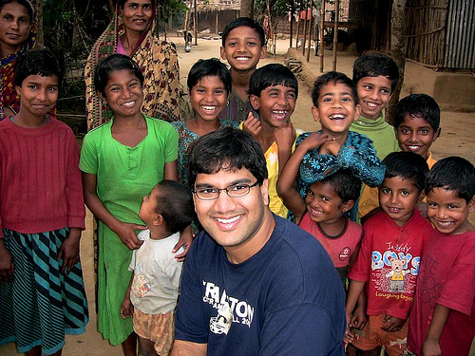
The Uncultured Project
21
Notes:
http://savetheworldblog.files.wordpress.com/2009/10/2606613587_44ea042f60.jpg
http://uncultured.com/

Slide 22
Turning 3 things upside down
Bottoms-up KM (Gmail case, Guru connecting)
Emerging countries leading (design for other 90%)
Children as forecasters (the technology is conversation, the safe conversation—like driving)
22

Slide 23
Some Potential Disruptive Themes
In-country corporations and the rise of CSR - supply-chain savvy corporations inviting NGOs to join their relief efforts
Beneficiary driven relief - The beneficiary kiosk – beneficiaries ordering relief supplies
Survivor assessments – survivors as sources for assessment and demand data (Ushahidi)
Renegade partners – in-country partners who decide to go it alone
Direct funders – direct connections to people and projects (Kiva, Uncultured)
23

Slide 24
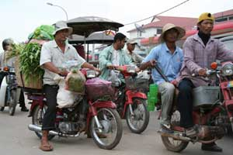
The Sometimes Connected Internet
Internet Village Motoman Network
24
Notes:
http://www.developingtelecoms.com/content/view/687/59/
Internet Village Motoman “Already, innovative ICT projects in Cambodia have helped connect remote rural schools to the internet,” said Tony Bates. “With NGN technology things can only get better.”
Cambodia was picking itself up and could show the way to several developing nations. Mr Bates went on to cite the example of a First Mile Solutions project called “Internet Village Motoman”, which used new ICT to provide internet access for 15 solar-powered village schools, telemedicine clinics, and the governor’s office in a remote province of Cambodia - using five Honda motorcycles.
The project worked by equipping new schools in the villages with solar panels on the roof to provide sufficient energy to run a computer for six hours and providing an e-mail link via a motorcycle delivery system.
Early every morning, five Honda motorcycles leave the hub in the provincial capital of Banlung, where a satellite dish donated by Shin Satellite links the provincial hospital and a special skills school to the Internet for telemedicine and computer training.
The motorcycle drivers, equipped with a small box and antenna at the rear of their vehicle that downloads and delivers e-mail through a wi-fi (wireless) card, begin the day by collecting the e-mail from the hub's dish, which takes just a few seconds.
Then, as they pass each school and one health centre, they transmit the messages they have downloaded and retrieve any outgoing mail queued in the school or health centre computer, also equipped with a similar book-sized transmission box. They then go on to the next school. At the end of the day they return to the hub to transmit all the collected e-mail to the Internet for any point on the globe.
“This is an example of technology changing the quality of life, it is testament to the power of engineering.” While the telecoms industry is “not inventing technology for technology’s sake, we respond to consumer demand across the broadest possible consumer base.”
TDS helped to highlight the fact that developing nations are now a major part of that consumer base, and have now become the primary focus of the telecommunication industry’s attention, particularly with regards to NGN technology, this also being the conclusion expressed elsewhere in this review, of Fernando Lagraña, Executive Manager of ITU Telecom World.
“The industry has the potential of benefiting the developing world in ways we hadn’t even deemed possible a few years ago,” he said. “We must ensure that the future of the industry is shaped by the needs of the least developed and developing world.”

Slide 25
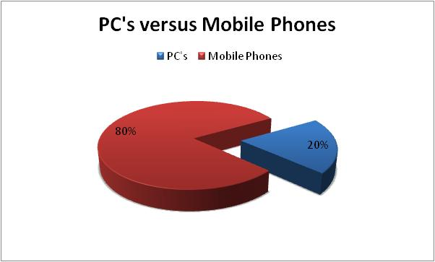
What’s your software platform?
25

Slide 26
Peters Law of Proximity
The amount of innovation is directly proportional to the distance from headquarters.

Slide 27
The New Collaboration
Who Are You Partnering With?
“Who has expertise I can trust?”
Shared Services & Assessments
SHARED
SPECIALIZATION
JOINT PROJECTS
“What can we build together?”
NRK, Phase 2 Satellites
Increasing Level of Trust
PARTNERING
“How can we work with corporations?”
Cisco, Microsoft, Intel Grants
BASIC INFO SHARING
“What are my peers doing?”
Meetings, Conference Calls

Slide 28
The Innovation Mutual Fund
I4 Health - MedCheck, a NetHope/Accenture initiative for battling the counterfeit drug trade.
I4 Microfinance - Mobile Banking pilot between NetHope, Accion and Microsoft, using Microsoft’s OneApp and PDAs/cell phones for Loan Approvals and Credit Scoring
I4 Education - eLearning and ICT Program for secondary schools with the Tanzanian government, NetHope Members, Accenture and others to reach 1.5M secondary school children.
I4 Geographic Information Systems - A hydrology/ water dataset sharing project in East Africa and a Disaster Preparedness pilot with partner ESRI.
28

Slide 29
Toward Relevant IT – A Manifesto
Mission-Moving Projects. Technology matters. We believe ICT can move missions, which is the most strategic application of ICT to which we can aspire
Good Enough Applications. Small is beautiful, faster to change, and fit for purpose
Shared Services. Sharing resources stretches and enhances what we do as individual organizations.
Lights-Out Infrastructure. To get in to mission moving app’s, we need to get out of basic IT operations. We need to shift the IT agenda from "lights-on" technology to “impact” technology.
Increased Experiments. Vary like mad. Pilot, prototype, trials. Partner to pilot: share the risks..
29

Slide 30
Six questions for Nonprofit Leaders
What new programs (that directly serve beneficiaries) have you helped engender that would not have been possible without the new use of technology?
What have you done to help close the "productivity gap" in the way your nonprofit delivers programs and operates as an organization?
How have you helped bridge the divide that will be caused by disruptive innovations in the nonprofit space?
For relief organizations: How have you helped disaster response be 50% faster with 50% greater impact?
How have you helped your organization attract and retain knowledge workers (and IT professionals) in the face of crisis of the baby boom generation retirement wave?
What are you doing to move commodity functions out of your organization and contribute time, dollars and support to the truly value-added functions of your agency?

Slide 31
A Fundamental Law of Disruption
If you don’t answer these questions
Someone else will

Slide 32
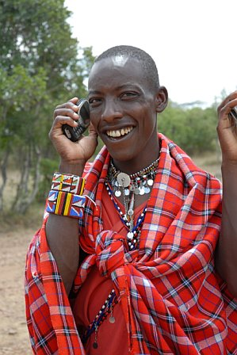
For the rest of the world, this is the Internet
32
32
Notes:
Masai Warrior at Ikelani Using Cell Phone, Jupiter research Blog, Julie Ask, October 06, 2006; http://weblogs.jupiterresearch.com/analysts/ask/archives/007174.html

Slide 33
III. Looking to the Future – Part 2

Slide 34
A metaphor to ponder
What was Picasso up to?

Slide 35
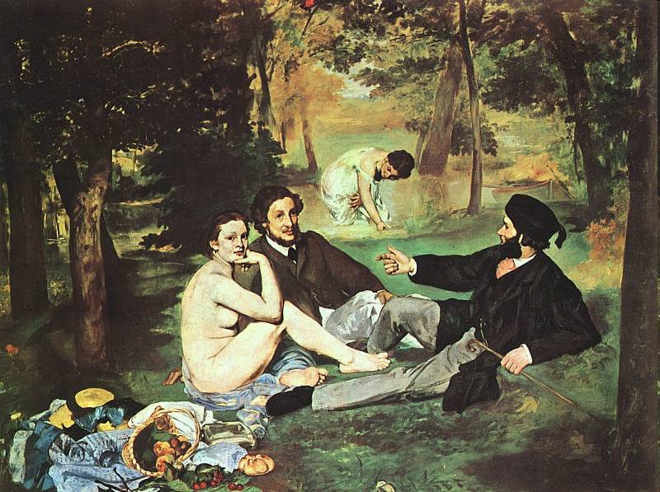
Manet’s Luncheon on the Grass, 1863
Notes:
http://www.artlex.com/ArtLex/r/images/Luncheon%20on%20the%20Grass.jpg

Slide 36

Picasso’s
Luncheon on the Grass (after Manet), 1961
Notes:
http://picasso.tamu.edu/picasso/WorksInfo?CatID=OPP.61:218
Also see: http://www.arthistoryclub.com/art_history/Pablo_Picasso

Slide 37
Picasso on technology?
Dialog with the past
Change the focus for the future
Embrace uncertainty

Slide 38
Everything Old is New
IT Pendulum between the Extremes
Left Brain (60s, 90s)
Centralized
Standardized
Generalized
Rationale
Autocratic
Big is Better
In-source
Tight
Right Brain (70s, 80s)
Decentralized
Customized
Specialized
Creative
Democratized
Small is Beautiful
Outsource
Loose
The next wave?

Slide 39
IV. Discover and Harvest

Slide 40
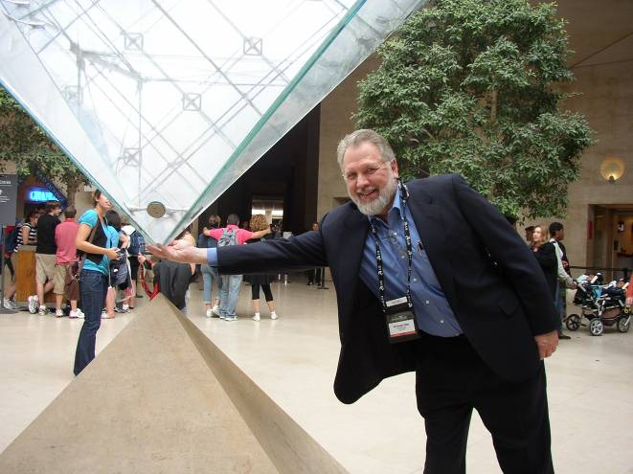
For The Da Vinci Code Fans

Slide 41
Where should we look for innovation and ideas?
Children, Students,
Emerging Countries
1. Citizen-facing
Field Tech’s, Field Workers, Partners
2. Field-facing
Increasing Distance from HQ
Corporations
3. Donor-facing
HQ
4. Supporting
Inverting the pyramid

Slide 42
Discover and Harvest
Jerry Sternin and positive deviance
  The value of discovering the exceptions
Traditional approach is more an “assess and build” approach:
  assess the situation, gather requirements, specify the project, build it, test it and deliver it.
  problem is that this approach has a dismal history
The “discover and harvest” approach:
  finding those applications and uses of technology in the far reaches of your organization that are already working.
Notes:
See the Fast Company article on Jerry’s work, “Positive Deviant,” by David Dorsey, November 30, 2000; here: http://www.fastcompany.com/magazine/41/sternin.html
Richard Tanner Pascale & Jerry Sternin, “Your Company’s Secret Change Agents,” Harvard Business Review, May, 2005.
“Positive Deviant,” Fast Company.

Slide 43
As Jerry would say “somewhere in your organization, groups of people are already doing things differently and better. To create lasting change, find these areas of positive deviance and fan the flames.”

Slide 44
Discover and Harvest has a number of benefits
It’s already working somewhere; it leapfrogs over getting a new system to work. The pilot has already been run.
Some group has already adopted it; it doesn’t need to be sold.
It’s field-tested. Especially for international NGOs working in challenged rural settings, it works where technology is rare.

Slide 45
Why Don’t We See More D&H Approaches?
It requires headquarters humility.
The best answers, especially if it involves change, need to be from the inside out.
  “Maybe the problem is that you can't import change from the outside in. Instead, you have to find small, successful but "deviant" practices that are already working in the organization and amplify them.”
Perhaps the CIOs role is chief amplifier. Find what’s working and can be taken to scale, and then shine the spotlight on it.

Slide 46
How to take a “discover and harvest” approach
Run a contest for people to submit their applications and uses of technology
Recognize and reward them (it doesn’t need to be a cash award.)
Put their name on the application. Most people take pride in what they do and want to be recognized for what they achieve.

Slide 47
Four Areas of Up-side Down Impact
  Bottoms-up knowledge management,
  The leadership of emerging countries,
  External collaboration driving the internal agenda, and
  Children as forecasters
All of these indicate the types of conversations we need to be having among nonprofits and with our corporate partners.

Slide 48
Bottoms-up Knowledge Management
“There is no shelf” –Clay Shirkey
  The triumph of folksonomies
  And deep-indexing
Finding the person rather than the content
  Connecting the front-line
  What’s the de facto social network?
The need to learn from what I do
  The problem of managing email
  The case of the email sabbatical

Slide 49
The Leadership Of Emerging Countries
The case of OLPC
  Creating the category of emerging country technologies
The case of the mo-ped server
  Disconnected email?
  What’s the value proposition for the bottom of the pyramid?

Slide 50
External Collaboration Driving the Internal Agenda
NetHope as a collaboration that works
“Why doesn’t the Alliance work like NetHope?”
  Building trust since 2001
  NGO IT as beggars – don’t underestimate under-funding
  Centers of excellence
Like-minded partnering – having impact with technology

Slide 51
The New Collaboration
Who Are You Partnering With?
“Who has expertise I can trust?”
Shared Services & Assessments
SHARED
SPECIALIZATION
JOINT PROJECTS
“What can we build together?”
NRK, Phase 2 Satellites
Increasing Level of Trust
PARTNERING
“How can we work with corporations?”
Cisco, Microsoft, Intel Grants
BASIC INFO SHARING
“What are my peers doing?”
Meetings, Conference Calls

Slide 52
Children As Forecasters
Question is not “what do you study to see the future”; it’s “who do you study?”
What a 10-year old uses for doing homework rivals what we have on NGO desktops; it will quickly surpass it
The Dartmouth Green Case – the technology is the conversation

Slide 53
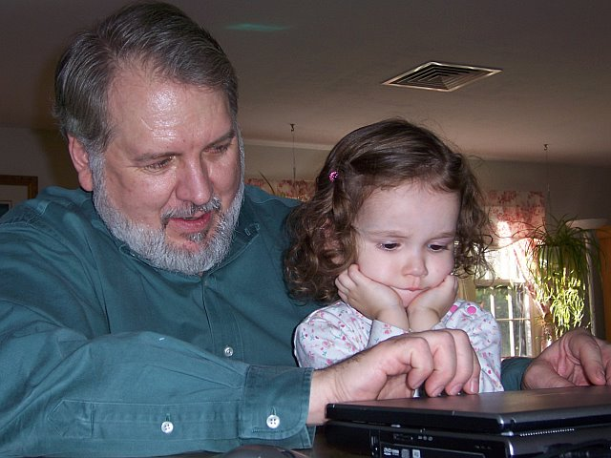
Remember: Who is Your Leading Indicator?

Slide 54
Remember: Who are you spending time with?
“If you’re a CIO, you need to spend a lot of time out on the fringes of the Web because that’s where the innovation’s taking place. You need to spend a lot of time with people under 25 years old.” –Gary Hamel
Notes:
Gary Hamel interview, CIO Magazine, November 15, 2007, p. 50-55.

Slide 55
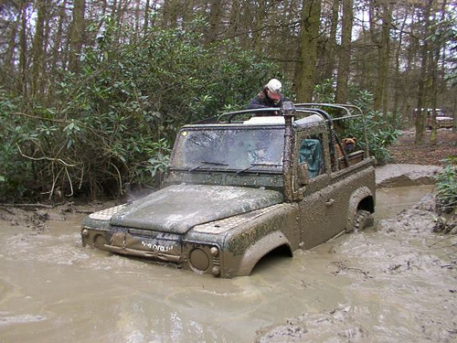
Stuck?
55
Notes:
http://farm3.static.flickr.com/2405/2116956923_98b45103fb.jpg

Slide 56
Moral of the Story
We cannot get the capacity gains we need in NGOs without working together more and sharing commodity resources
We cannot go it alone!

Slide 57
Session 1: Future of IT in Nonprofits
Recognize the role of technology in moving missions forward
Use pyramid framework to strategically understand different roles of technology in organizations
Learn where to look for future trends before they disrupt you
Use the “discover and harvest approach” to discover and amplify pockets of innovation

Slide 58
Further Reading
Blogs:
http://eghapp.blogspot.com/
http://granger-happ.blogspot.com/ (Dartmouth Fellowship)
Web site (see the articles & presentations link) http://www.fairfieldreview.org/hpmd/EGHprofile.nsf
Email: ehapp@ifrc.org
Twitter: @ehapp
And the book:
Managing Technology to Meet Your Mission, chap. 11.

Slide 59
Questions?

Slide 60
Appendices

Slide 61
Key Questions We Cannot Yet Answer In Nonprofits
How can we seamlessly operate disconnected?
How do we co-operate with technology partners? (i.e., shared services)
How can we deliver programs in new ways with technology? (changing the delivery model)
What is the portfolio of basic phone-based applications that works in the field?
What is the portfolio of bite-sized operating applications that works in an underfunded HQ business model?

Slide 62
A Triad of IT Drivers
Metcalf’s Law
the network effect is exponential
Nielsen’s Law
high-end user's connection speed grows by 50% per year
Moore’s Law
CPUs double
every 18 months

Slide 63
